Slide 1

NAME:NIMISHA GODGHATE PRN:202401080007 ROLL NO:CS7-08 TOPIC:UNDERSTANDING NESTED FOR LOOP AND ONE EXAMPLE

Slide 2
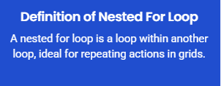
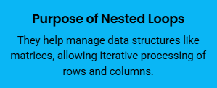
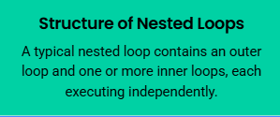
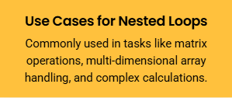
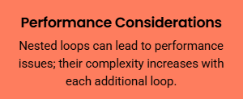
Understanding nested for loop

Slide 3
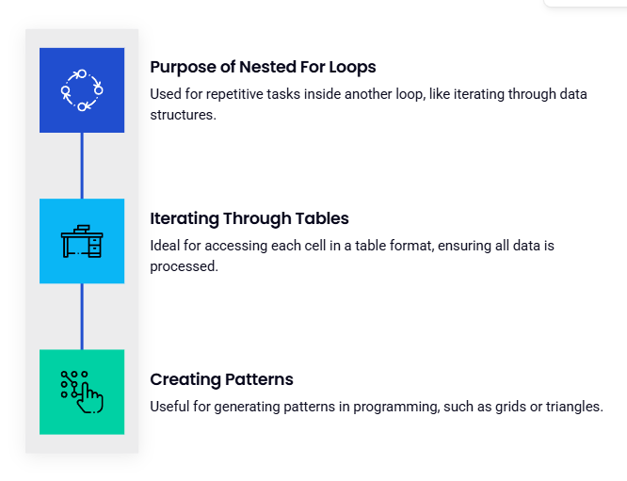
Nested for loop

Slide 4
Code: for i in range(1, 6): # Rows: 1 to 5 for j in range(1, 6): # Columns: 1 to 5 print(i * j, end="\t") print()

Slide 5
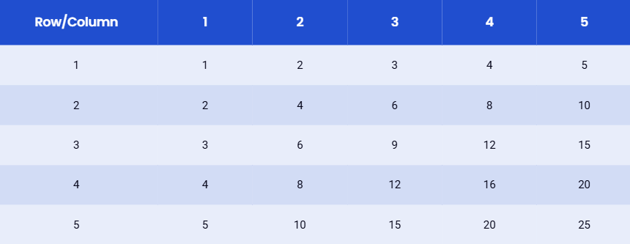

Slide 6
Logical Mistakes Be cautious with loop ranges to prevent logical errors, such as infinite loops, which can cause the program to hang.
Performance Issues
Nested loops can lead to significant performance degradation, especially with high iteration counts, resulting in millions of operations.
Indentation Errors
Proper indentation is crucial in nested loops to avoid syntax errors and unintended behavior in the code execution.

Slide 7
THANK YOU

